Slide 1

Machine learning for tunnel condition assessment
Jack Smith
Company Logo

Slide 2
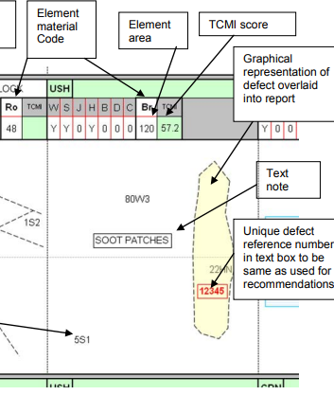
Visual condition assessment
Defect identification is manual
Analysis is lengthy and subjective
Reports are standardised in TCMI
(Tunnel Condition Marking Index)
Extract of TCMI report (NR_L3_CIV_006_4c)

Slide 3
Machine learning in tunnelling

Slide 4
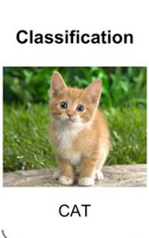
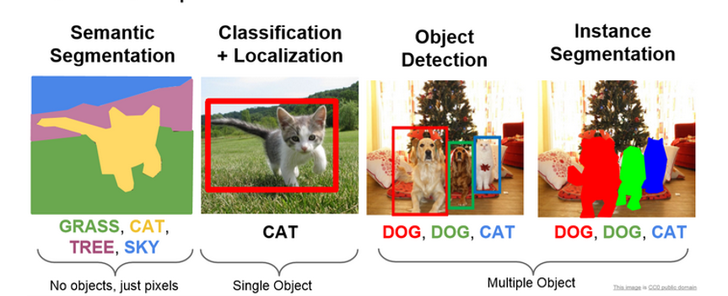
What can machine learning do?

Slide 5
Types of Artificial Intelligence
AI
Symbolic
(Knowledge representation and reasoning)
Connectionist
(Machine learning)

Slide 6
Types of Artificial Intelligence
AI
Symbolic
(Knowledge representation and reasoning)
Connectionist
(Machine learning)
Bottom up approach
learned parameters
Flexible and easy to use with large datasets and complex relationships
Top down approach
Rule based and explainable
Handcrafted and understandable reasoning method

Slide 7
Types of machine learning
Machine learning
Supervised
Unsupervised
Reinforcement
Notes:
Outline deep learning
What is machine learning
What is a neural network
Applied to images CNN
Encoder decoder
Skip connections
Code using python/pytorch run on desktop GTX970

Slide 8
Types of machine learning
Machine learning
Supervised
Unsupervised
Reinforcement
Notes:
Outline deep learning
What is machine learning
What is a neural network
Applied to images CNN
Encoder decoder
Skip connections
Code using python/pytorch run on desktop GTX970

Slide 9
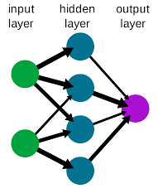
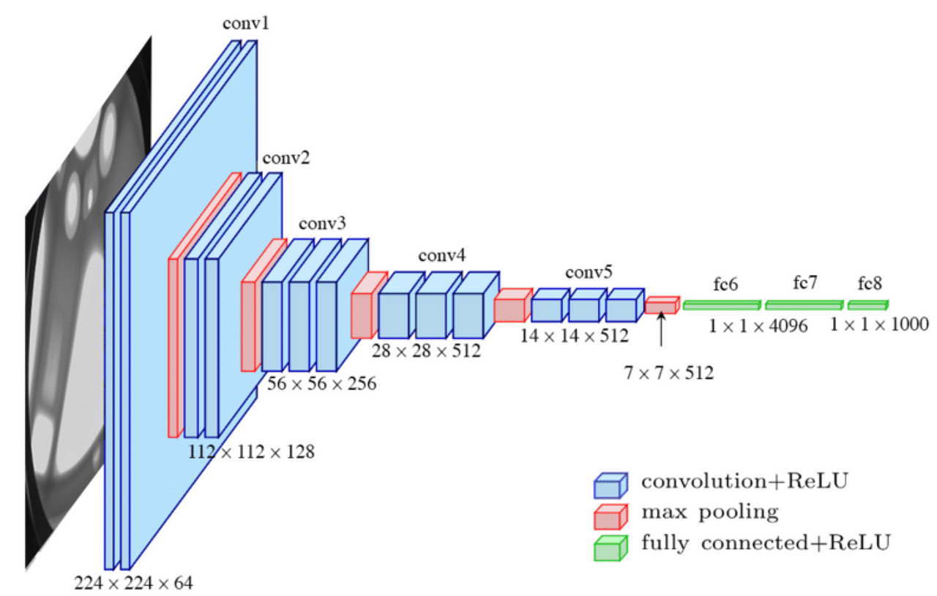
Neural networks
Shallow Neural Network
Deep convolutional Neural Network
(Wikipedia.com)
VGG16 architecture (Simonyan & Zisserman, 2014)
Notes:
Outline deep learning
What is machine learning
What is a neural network
Applied to images CNN
Encoder decoder
Skip connections
Code using python/pytorch run on desktop GTX970

Slide 10
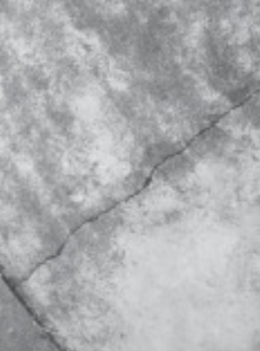
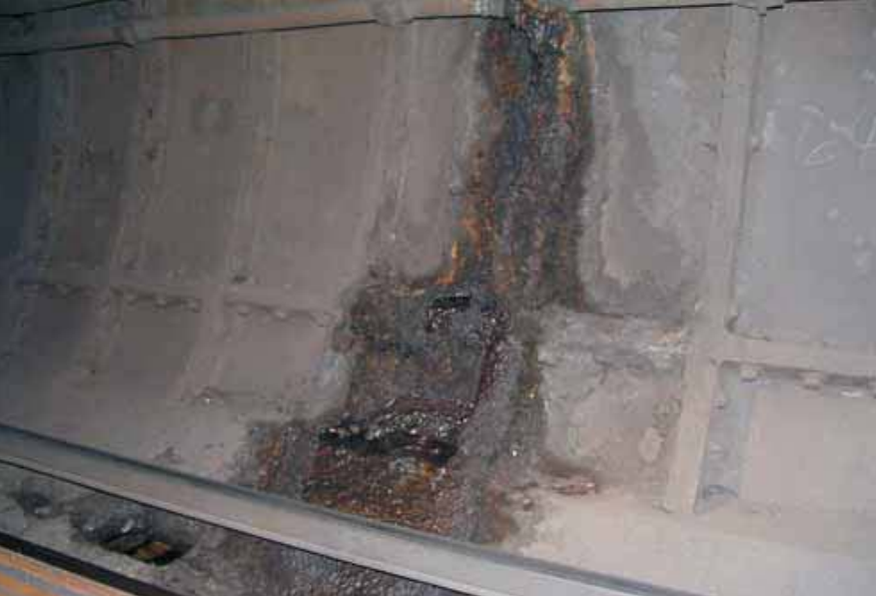
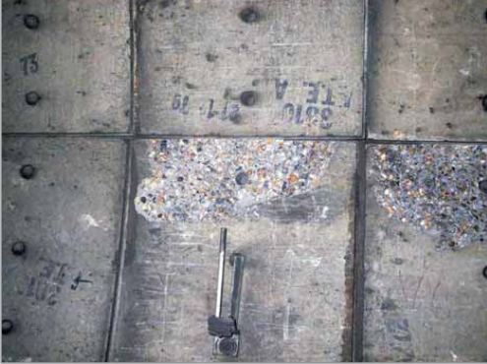
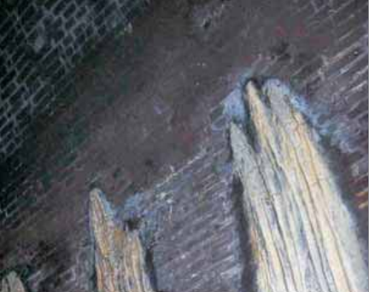
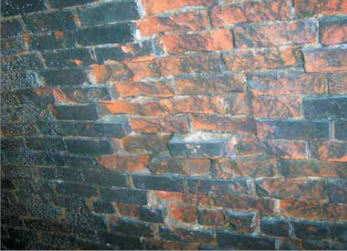
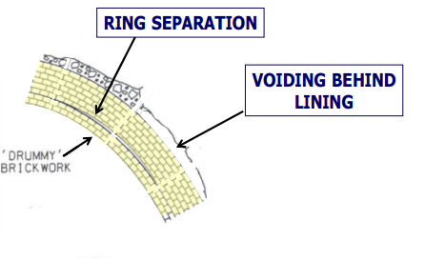
Tunnel pathologies
Example tunnel defects (Ciria C671 & NR_L3_CIV_006_4c)

Slide 11
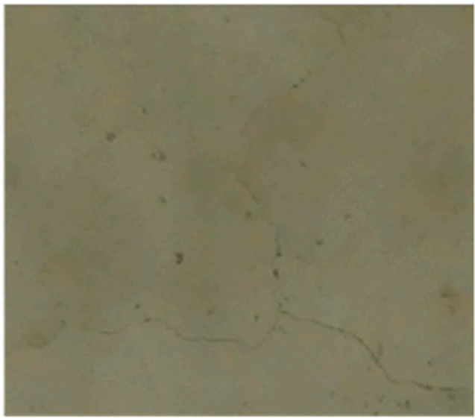

Concrete tunnel crack detection
Input Image
Output Image

Slide 12

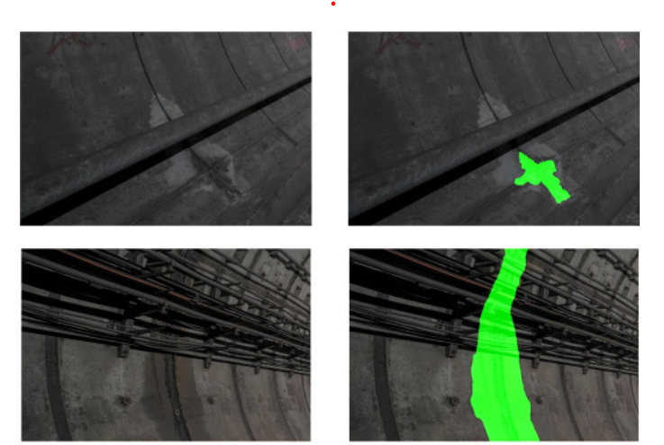
Metro tunnel leakage segmentation
Input Images
Output Images

Slide 13
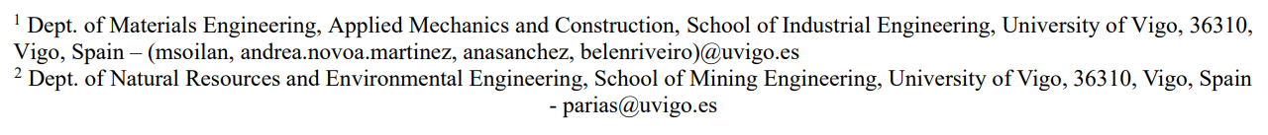
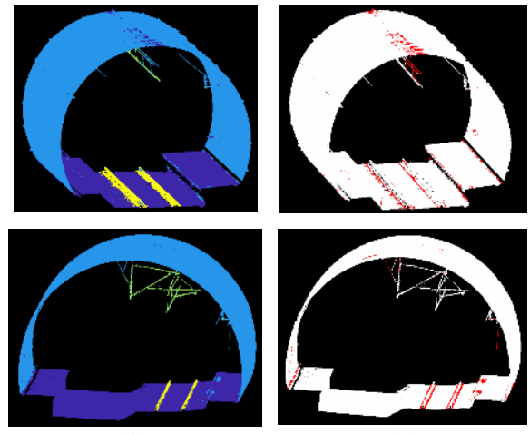
Tunnel part segmentation
Input Images
Output Images

Slide 14
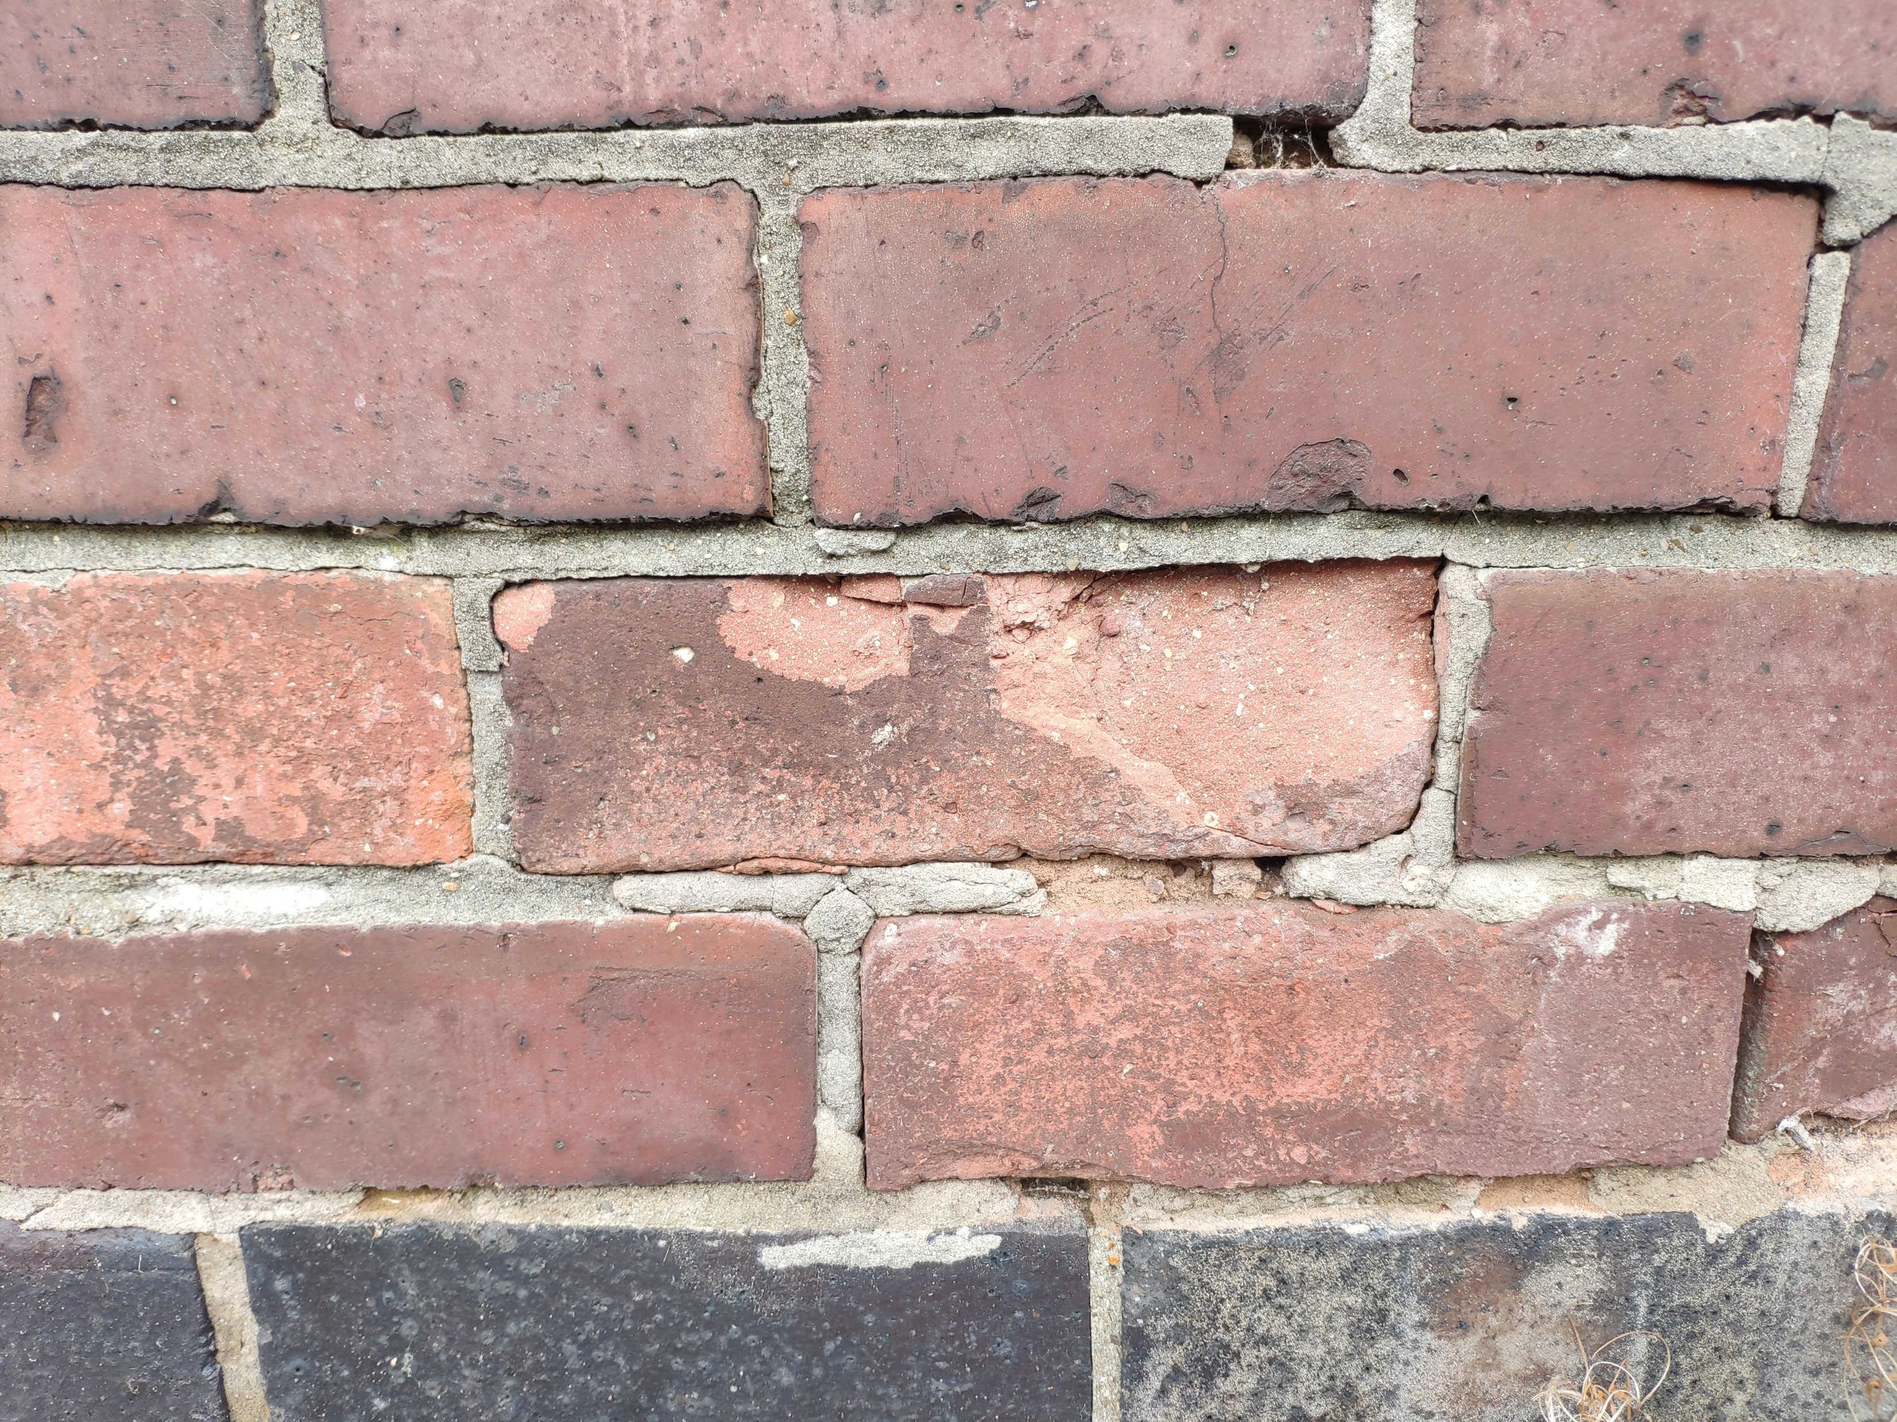
Masonry tunnel spalling severity segmentation
S1
S2
S3
Depth of spalling

Slide 15
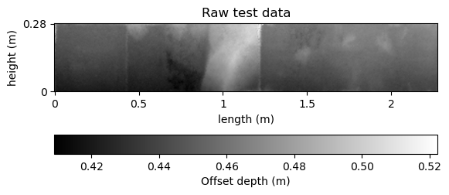
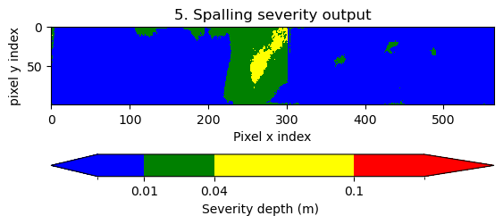
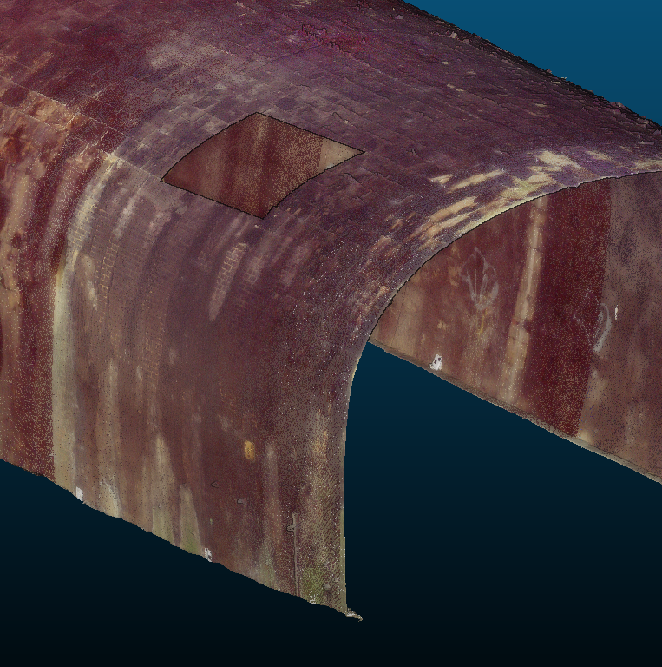
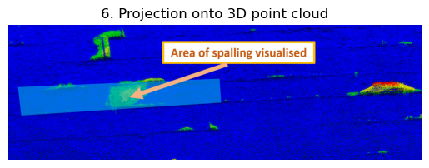
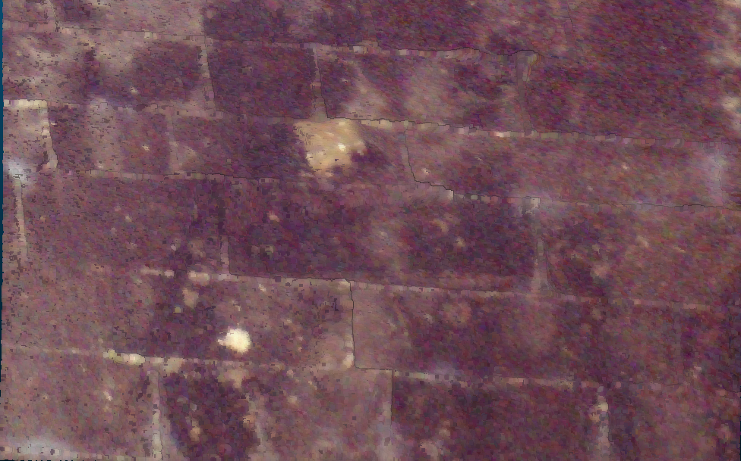
Masonry tunnel spalling severity segmentation
Spalling severity levels
Automated spalling severity output

Slide 16
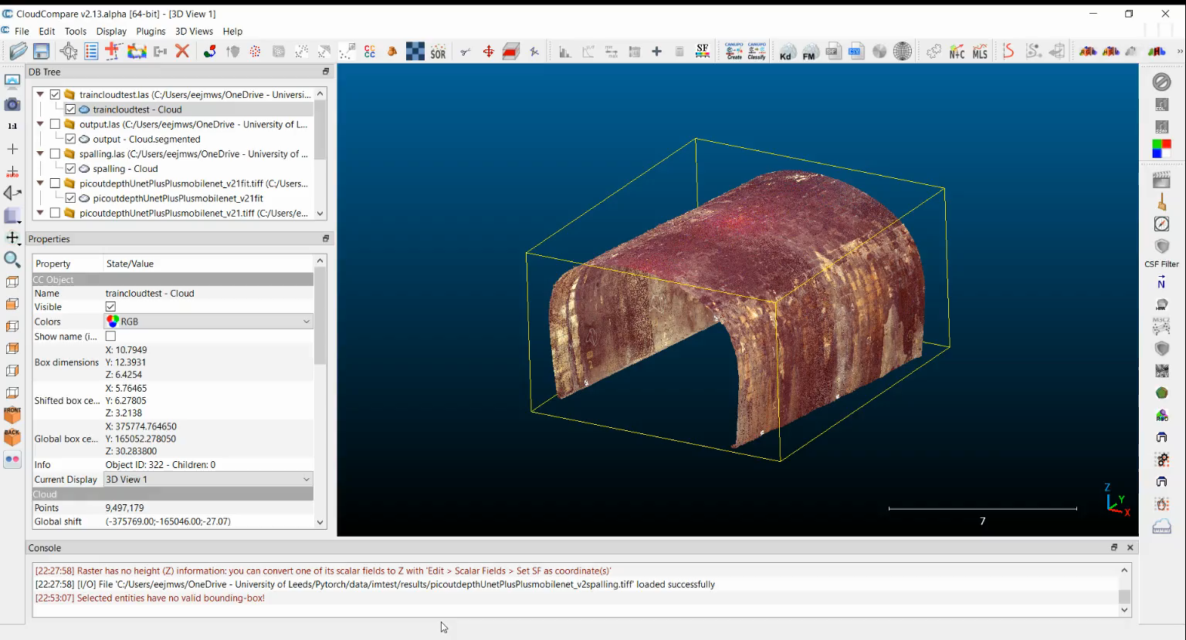
Masonry tunnel spalling severity segmentation
Automated spalling marking
Input Point Cloud
Unroll and rasterise
Determine masonry block joint locations
Determine damage locations
Automatic severity calculation
Fit undamaged surface and calculate offsets
Determine defect severity
Notes:
-runtime depends on blocksize
7 mins for 200m^2, so roughly 2 seconds per m^2 for stone block
7 mins for 200m^2, so roughly 2 seconds per m^2 for stone block
Brick roughly 4 times as long

Slide 17
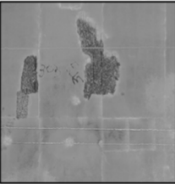

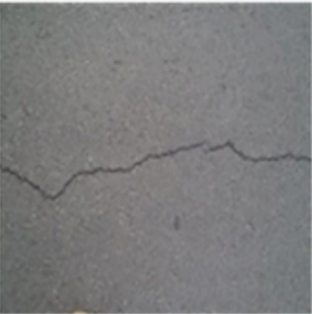

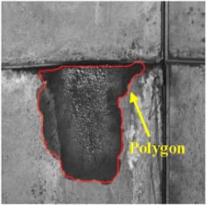

Neural network training
Determine input data
Split data training/validation/testing
Setup target mask
Setup training network hyperparameters
Run training to minimise validation loss
Defect type | Input image | Training mask
Concrete spalling
Concrete cracking
Water Ingress

Slide 18
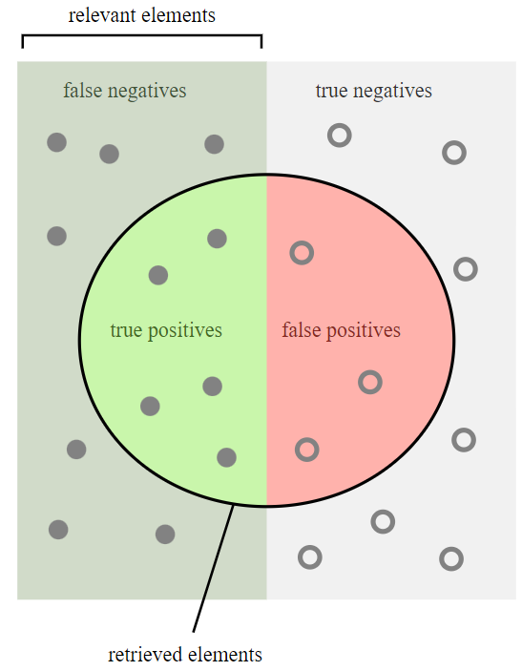
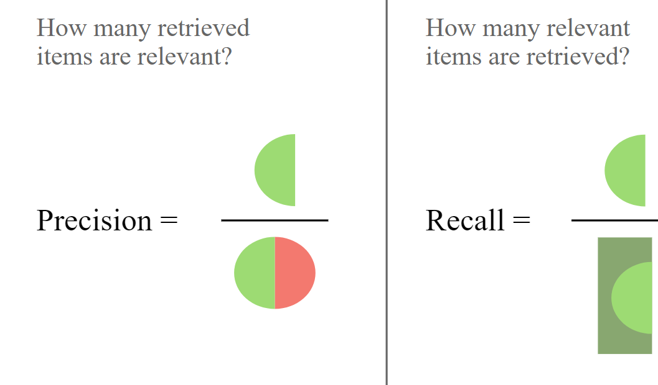
Performance assessment
Precision and Recall

Slide 19
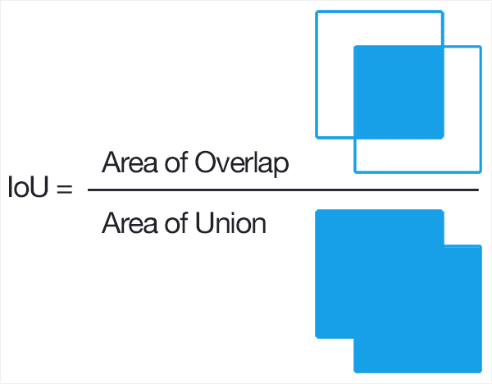
Performance assessment
Intersection over Union

Slide 20
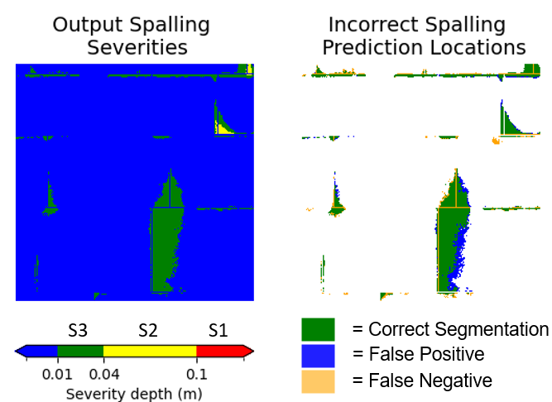
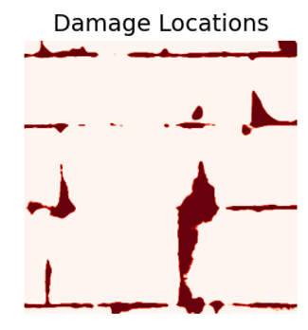
Performance assessment
Qualitative analysis

Slide 21
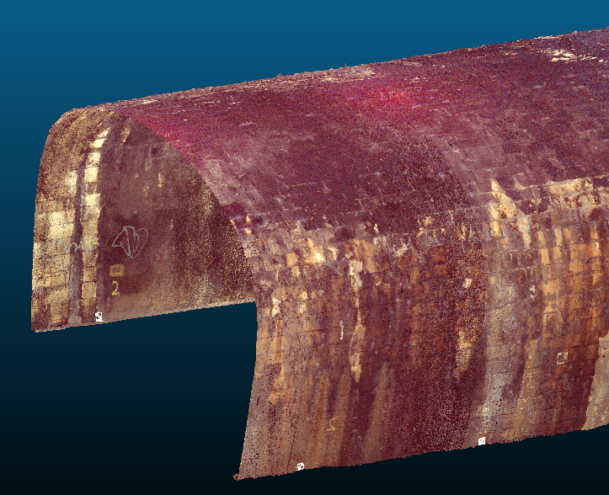

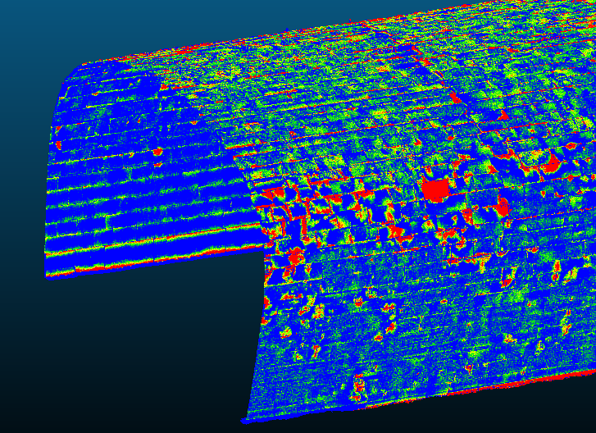


Machine learning potential
Capability | Status
Can reduce analysis time
Improves assessment reproducibility
Improves inspection health and safety
Replaces a human engineer
Can be used ‘off the shelf’
Requires advanced data collection equipment

Slide 22
Thank you

